Slide 1



R Markdown
one giant leap towards reproducible research
Notes:
Set the scene:
Open up a blank Word doc. Type out “Best wishes,” 10X
Use the keypad to type out “76.51” 10X.
How many mistake did I just make?

Slide 2
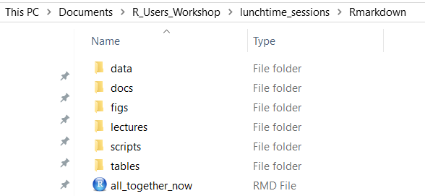

Previously…
Notes:
Re-orientate the group with the project structure from the last day

Slide 3
Tell them about how you used to scare 4th years
Notes:
Past life as a biologist
Might have eight weeks in the lab. What happens if it takes a week just to run a single experiment to completion
Western blot example

Slide 4
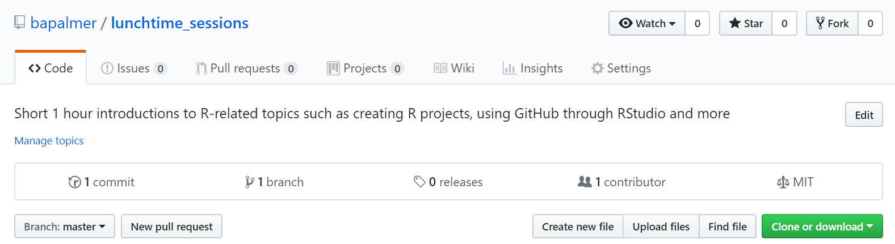
Today…
https://github.com/bapalmer/lunchtime_sessions

Slide 5
R Markdown
R Markdown combines the code you wrote, the output produced and you own comments
You can view it as a digital lab notebook, where you are both recording what you’re doing, and what you were thinking while you were doing it!
R Markdown outputs can take many forms
Word documents, PDFs, slideshows etc.
Once created the .Rmd file get sent to knitr, which executes the chunks of code and creates a new markdown document
this is then processed by pandoc which creates the finished file
knitr and pandoc are external websites
Notes:
? is not really available for R markdown due to the processing steps
The main advantage of the two stage process is that there are a wide range of options available

Slide 6
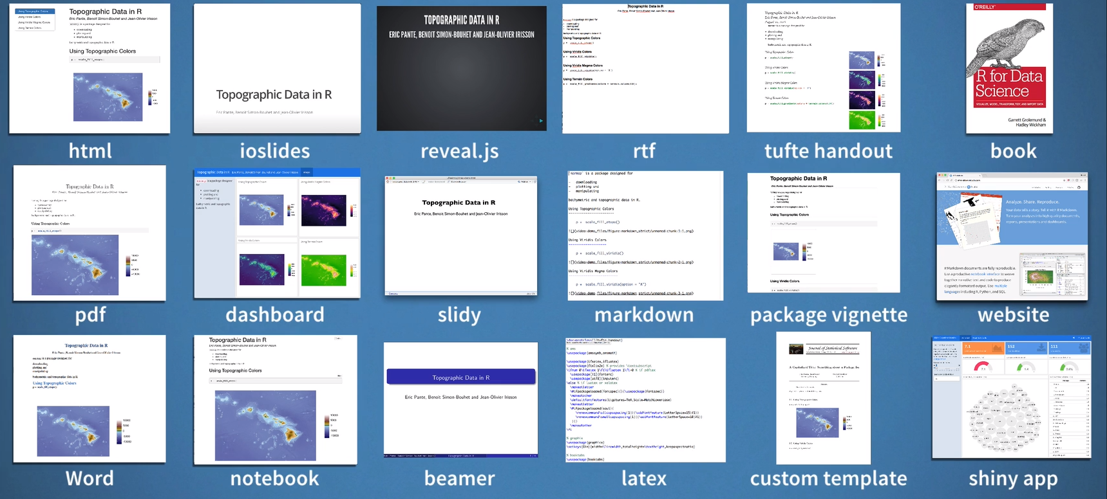
What has R Markdown ever done for us?
Notes:
Reproducible record of your work and easy to track in a version control system like Git

Slide 7
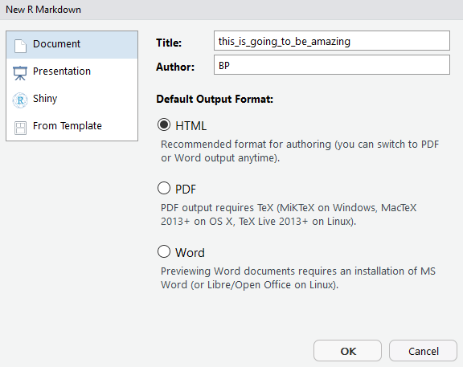
R Markdown
Notes:
Be sure to let them know that the location of the Rmd file is outside the folders so that the paths to the data, figures etc work.

Slide 8
R Markdown
---
title: "Diamond sizes"
date: 2016-08-25
output: html_document
---
```{r setup, include = FALSE}
library(ggplot2)
library(dplyr)
smaller <- diamonds %>%
filter(carat <= 2.5)
```
We have data about `r nrow(diamonds)` diamonds. Only
`r nrow(diamonds) - nrow(smaller)` are larger than
2.5 carats. The distribution of the remainder is shown below:
```{r, echo = FALSE}
smaller %>%
ggplot(aes(carat)) +
geom_freqpoly(binwidth = 0.01)
```
YAML header
Chunks of code
Plain text with data outputs from R code
Chunks of code
Notes:
Think of a chunk of code as a function. It should be self contained and focused around a single task
YAML is a human-readable data serialization language
Mention that python and other code can be used in Rmarkdown documents as code chunks

Slide 9
In the future researchers will be…
Writing their research papers in R Markdown
Some are doing it already
rticles package
Notes:
The rticles package is designed to simplify the creation of documents that conform to submission standards. A suite of custom R Markdown templates for popular journals is pr
The rticles package (Allaire, Xie, R Foundation, et al. 2018) is designed to simplify the creation of documents that conform to submission standards. A suite of custom R Markdown templates for popular journals is provided by the package
ovided by the package

Slide 10
Introduction to R Markdown
We’re now going to look at a R Markdown file that provides some of the tips and tricks you’ll need yourselves
Code chunks
Formatting
Tables
Figures etc.
Open the R Markdown file Rmarkdown_intro.rmd
Open the R Markdown file code_chunks.rmd
Notes:
Don’t forget to navigate to the docs folder and view the cheatsheets

Slide 11
R Markdown workflows
Open the R project in the Rmarkdown folder
try your hand at building an R Markdown file
play around with directly writing code
use the source command to load the R scripts
Open the R Markdown file putting_the_pieces_together.rmd
Notes:
The rticles package is designed to simplify the creation of documents that conform to submission standards. A suite of custom R Markdown templates for popular journals is provided by the package

Slide 12

Notes:
https://www.youtube.com/watch?v=s3JldKoA0zw

Slide 13
R Markdown workflows
Tips:
Ensure each notebook has a descriptive title
If you reach a research dead end, don’t delete it
Write a note about it. It may be useful later
Don’t modify errors in the data file directly
Correct it within the cleaning script
At the end of each day run a clean knit of the note book
If there’s an error message, correct it while its still fresh in your mind
If you want your code to be reproducible in the long run, you’ll need to keep a rigorous track of the package versions
Consider using the packrat package to help with this
For an deeper dive into R Markdown visit
https://bookdown.org/yihui/rmarkdown/
Notes:
The rticles package is designed to simplify the creation of documents that conform to submission standards. A suite of custom R Markdown templates for popular journals is provided by the package

Slide 14

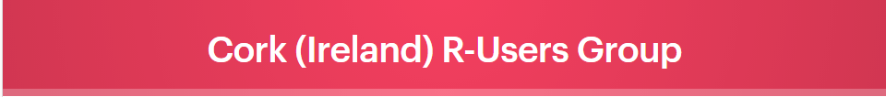

Notes:
One of the outcomes of this workshop is to look at developing a group of R users in Cork who are willing to come together and solve one another's problems and share experiences of using new packages and features.

Slide 15
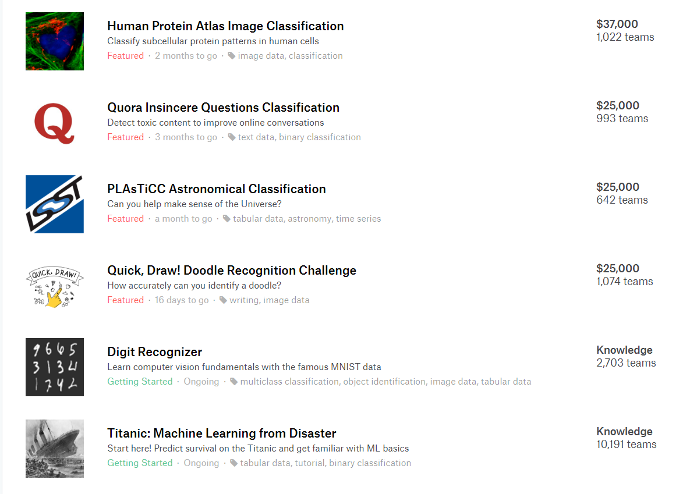
Notes:
Mention the Kaggle idea

Slide 16

GitHub
track changes on steroids
17th December 2018

